Slide 1
Agenda for GEOG260/360 GIS & Land Change Models
September 27
Get instructions for Assignment 4
October 2
Discuss Assignment 3
Discuss Assignment 4
Get familiar with the Extract module
How do we interpret output numbers from a neural net?
October 4
Submit Assignment 4 by 4pm on Canvas
Get instructions for Assignment 5

Slide 2
Assignment 4
Perform two runs with TerrSet’s Land Change Modeler (LCM) to simulate the transition from Non-Built to Built. For both runs, the Earlier land cover image is 1971Built1 and the Later the land cover image is 1985Built1. Do not ignore transitions less than 1000 cells. The only independent variable is elevation02. Use MLP to generate transition potential values for the transition from Non-Built to Built. For the first run, use the Markov matrix that derives from 1971-1985 to predict 1999. For the second run, use a Markov matrix that converts 0.6 of Non-Built to Built and 0 of Built to Non-Built to predict 1999. Use the three-way CROSSTAB including a mask to make validation maps for each run. Use REGRESS to plot the transition potential versus elevation02 with an appropriate mask. Submit exactly five slides as follows:
The first slide gives the author(s) name(s).
The second slide shows both validation maps from CROSSTAB that compares three maps with mask01. Describe how the Markov matrix for each run relates to the number of Misses, Hits, and False Alarms for each run.
The third slide shows validation maps that the Land Change Modeler generates for each run. Describe the limitations of the validation maps from the Land Change Modeler.
The fourth slide shows the elevation02 map, the transition potential map, and an appropriate mask to use with the REGRESS plot. Show the output from REGRESS. Describe why you used the mask that you did. Interpret the relationship among the four graphics on the fourth slide.
The fifth slide compares the transition potential values from MLP to the suitability values from Assignment 2 run 1.

Slide 3
Rubric for assignment 4
Submit exactly one slide with your name(s). 5 points
Submit exactly one that includes the following bullets. 35 points
The validation maps from CROSSTAB which compare three maps with mask01. 30 points
A paragraph that describes how the Markov matrix for each run relates to the
number of Misses, Hits, and False Alarms for each run. 5 points
3. Submit exactly one slide that includes the following bullets. 25 points
A group of validation maps that the LCM generates for each run. 20 points
A paragraph that describes the limitations of the validation maps from the Land Change Modeler(LCM). 5 points
4. Submit exactly one slide that includes the following bullets. 20 points
A group of an elevation 02 map, the transition potential map, and an appropriate mask to use with the REGRESS plot. 5 points
A clipboard of output from REGRESS. 5 points
A paragraph that describes why you used the mask that you did. 5 points
A paragraph that interprets the relationship between bullet 4(a) and bullet 4(b). 5 points
5. Submit exactly one slide with a paragraph that compares the transition potential values from MLP to the suitability values from Assignment 2 run 1. 10 points
6. Bonus. 5 points

Slide 4
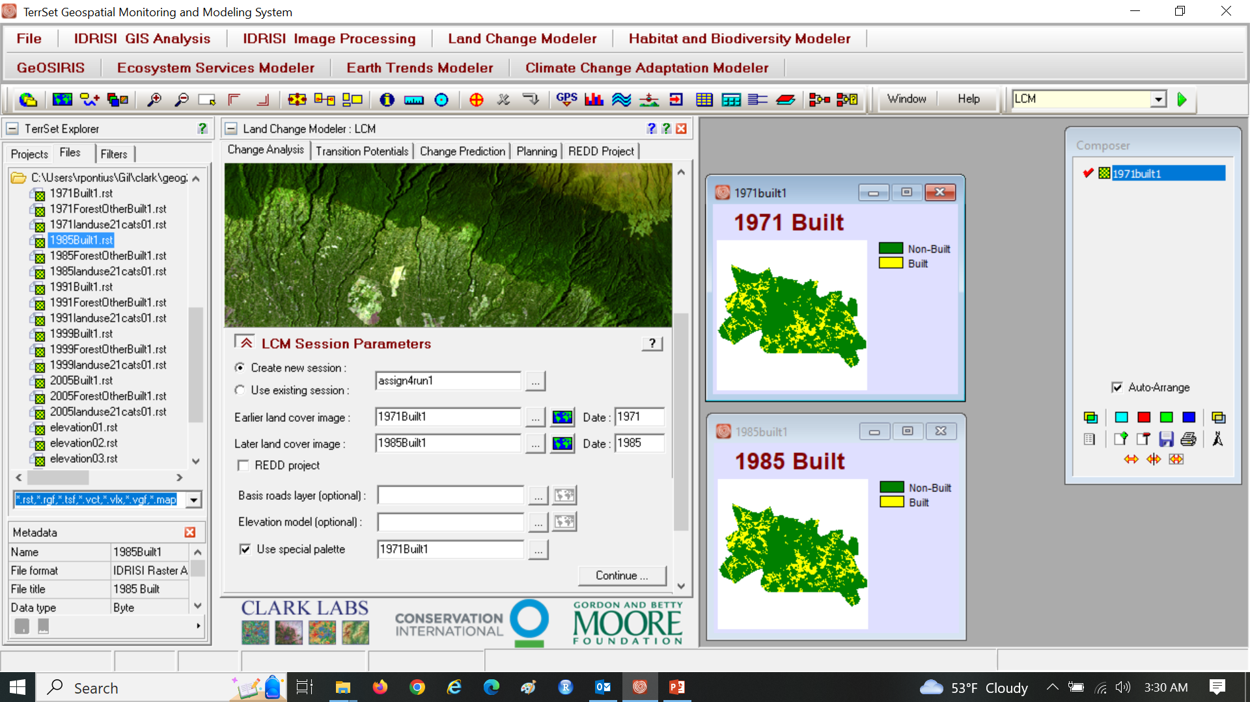
Assignment 4

Slide 5
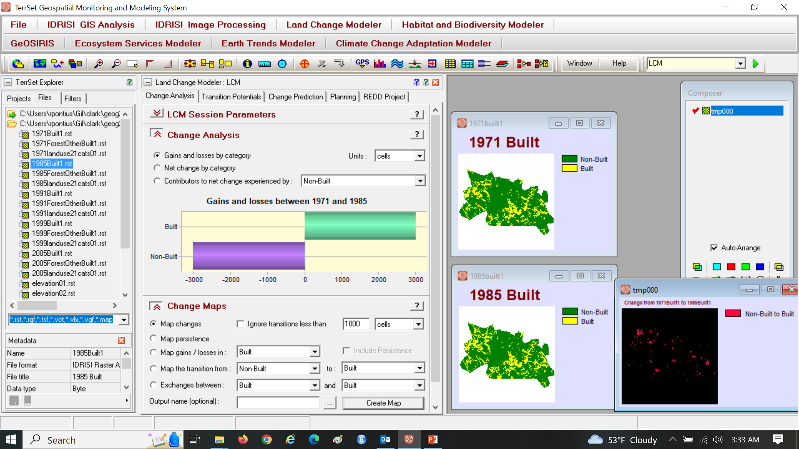
Keep the default to not ignore transitions less than …

Slide 6
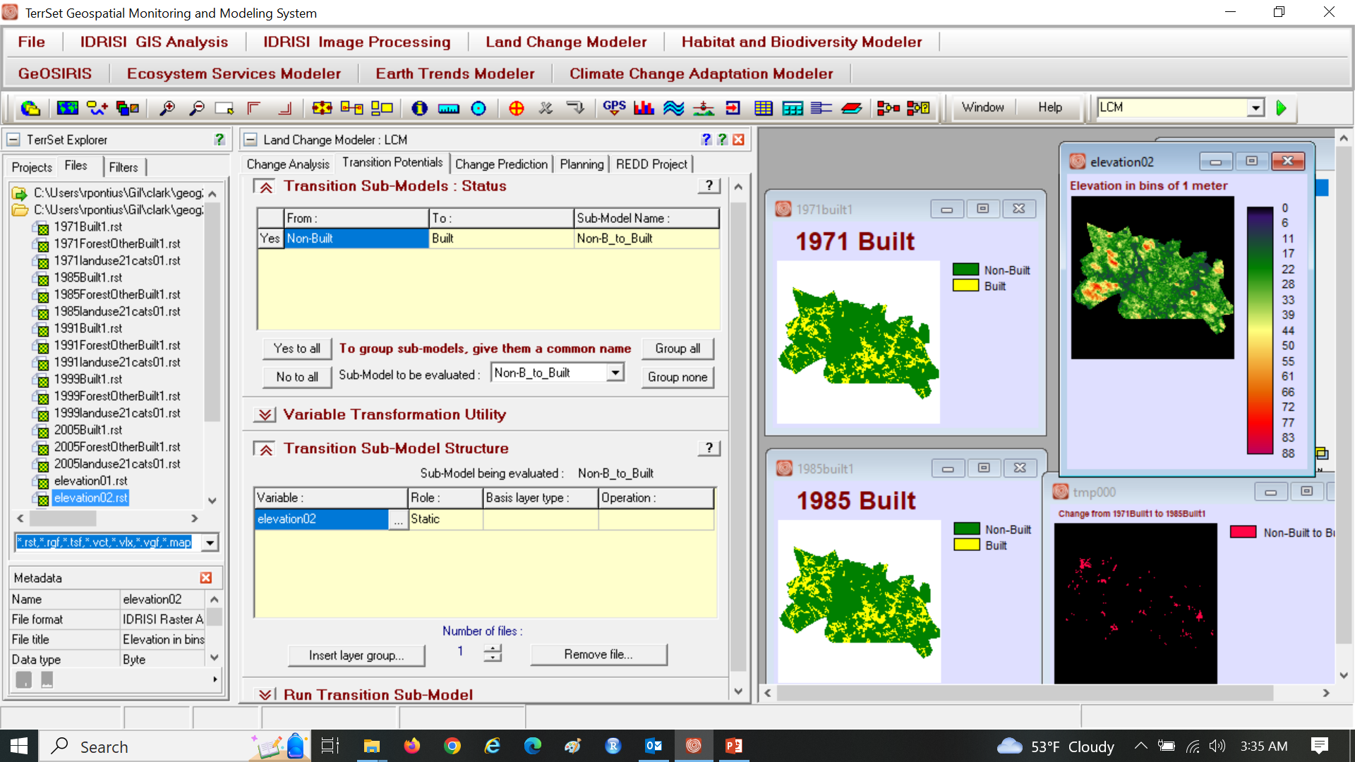
Use elevation02 as the independent variable

Slide 7
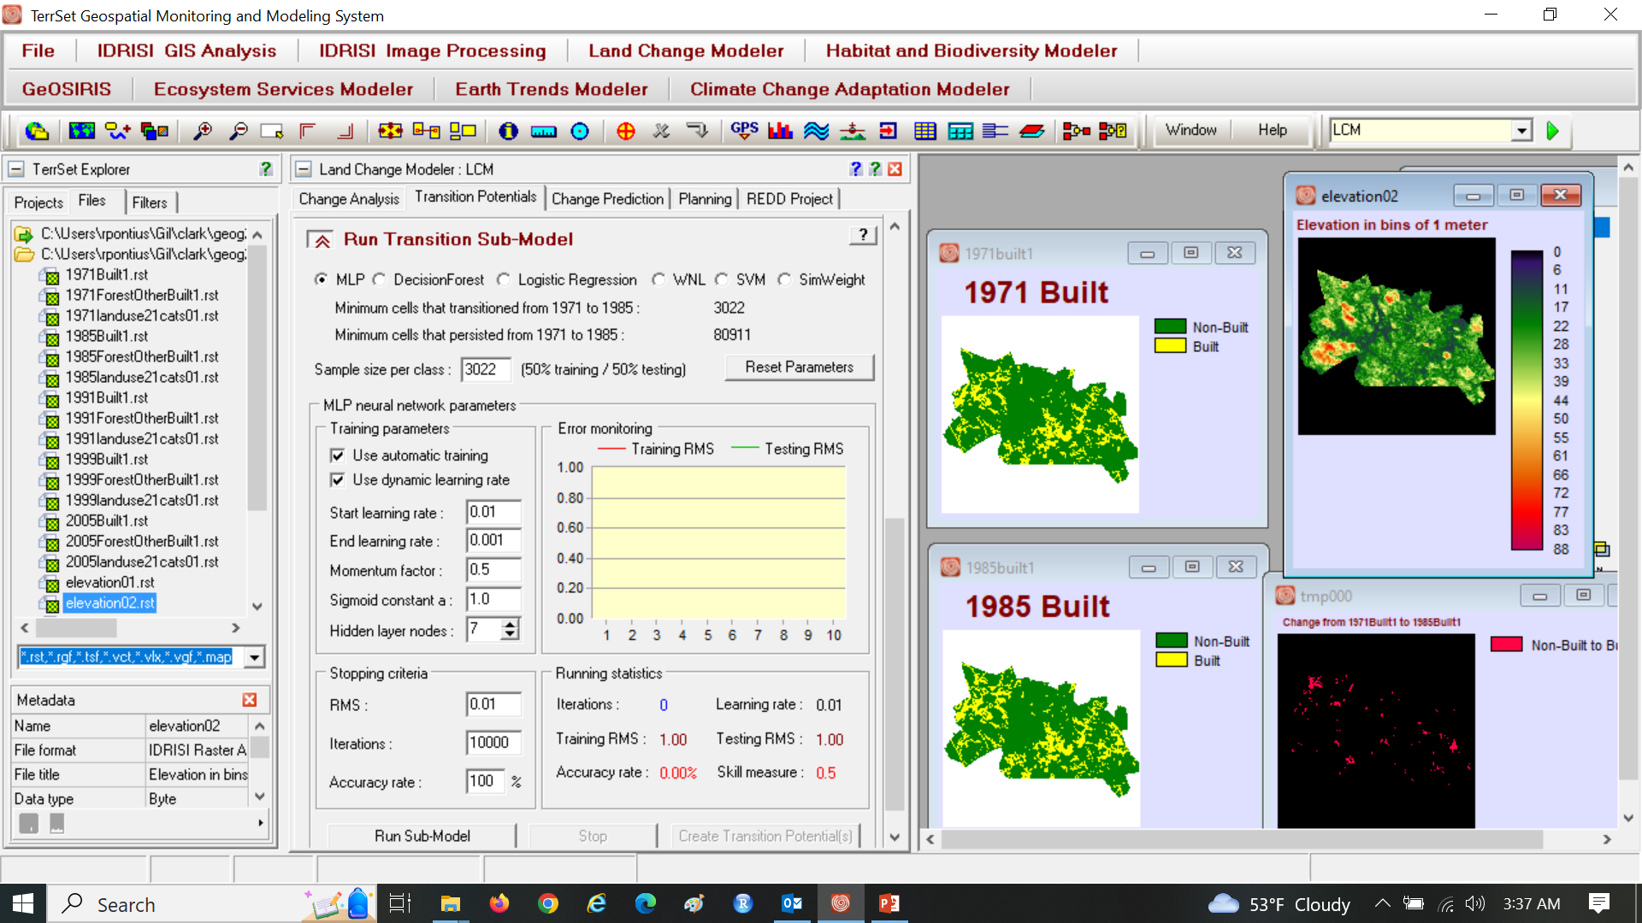
Use MLP with the default parameters

Slide 8
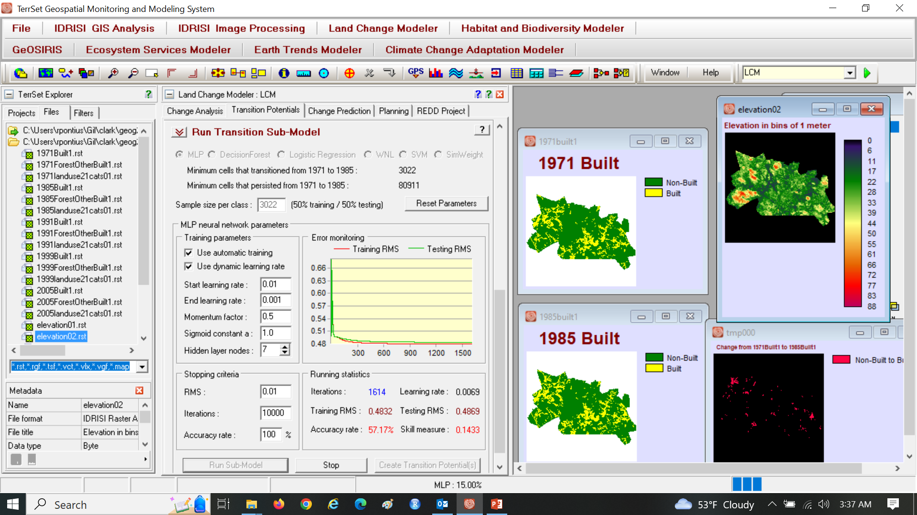
Assignment 4

Slide 9
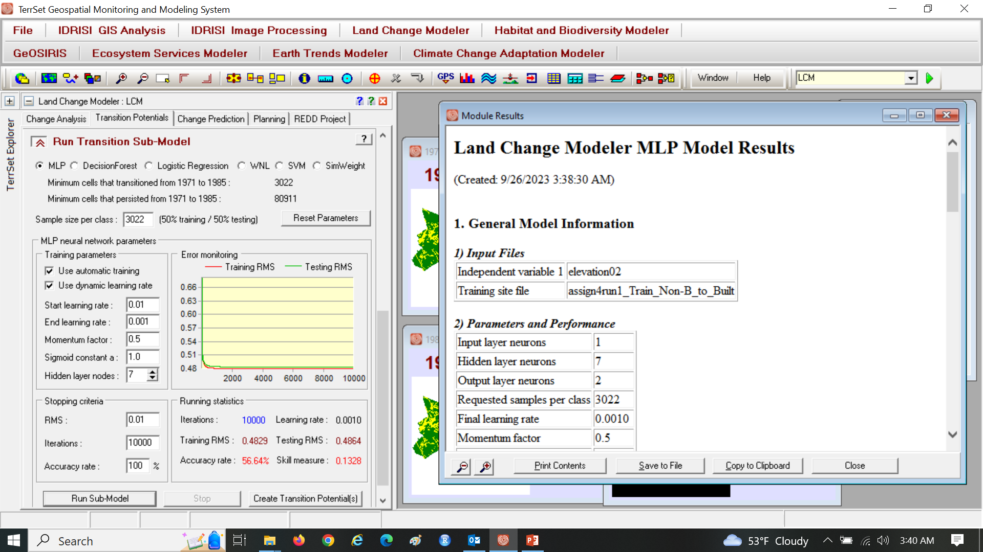
Note why MLP stops, which is likely at 10000 iterations

Slide 10
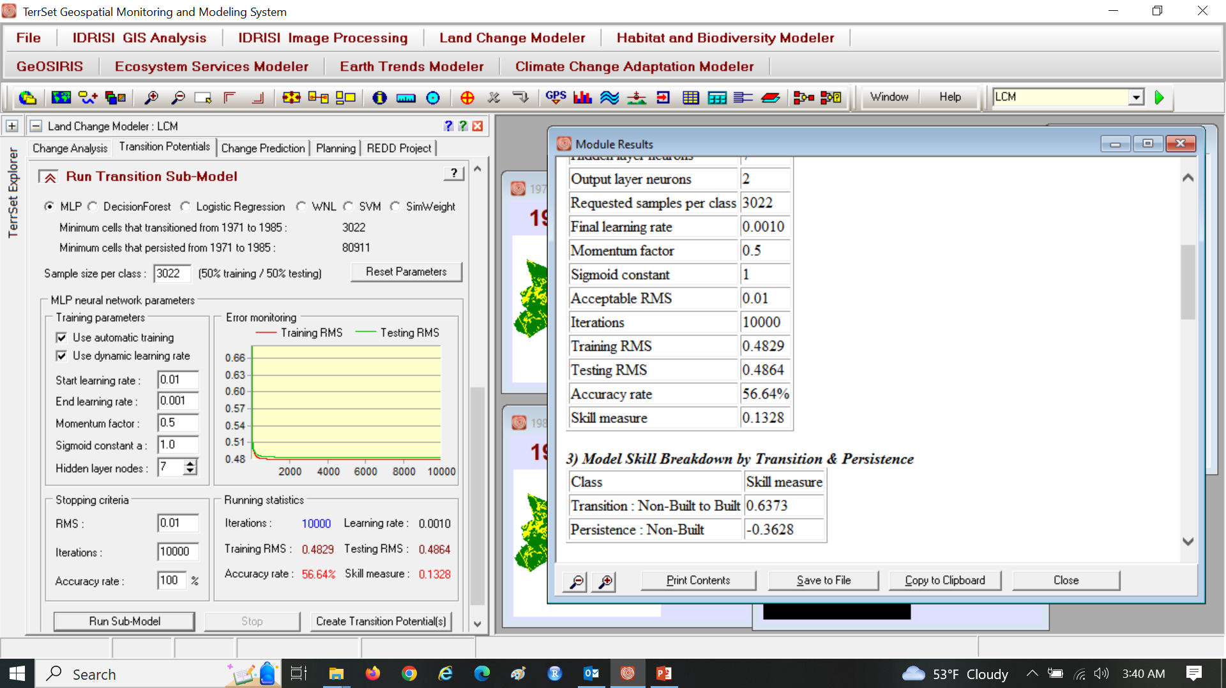
Note how elaborate the output is.

Slide 11
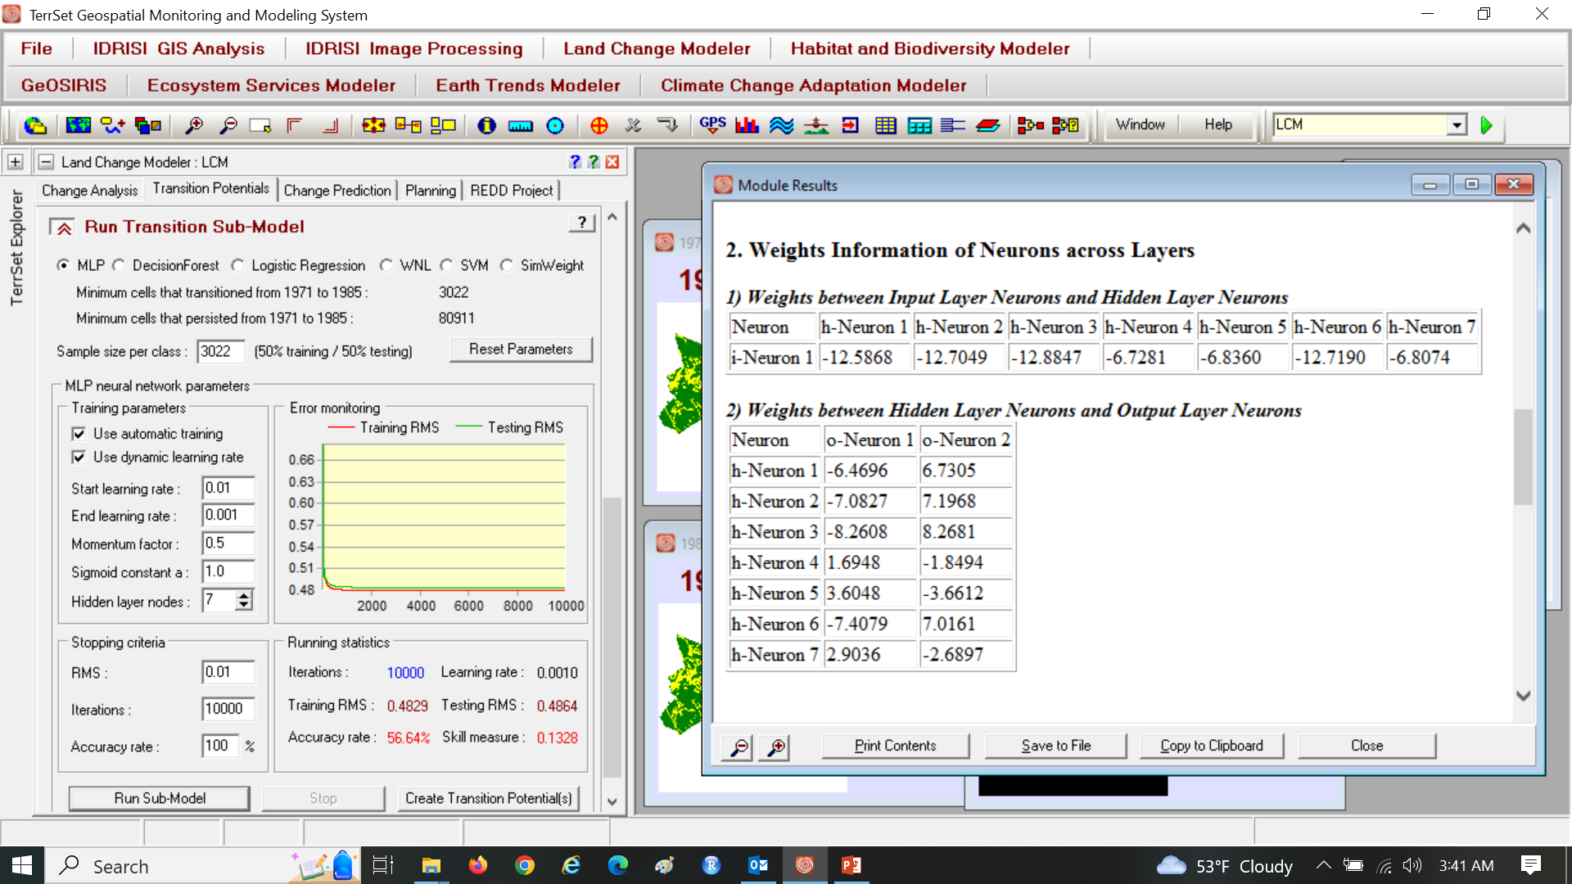
Assignment 4

Slide 12
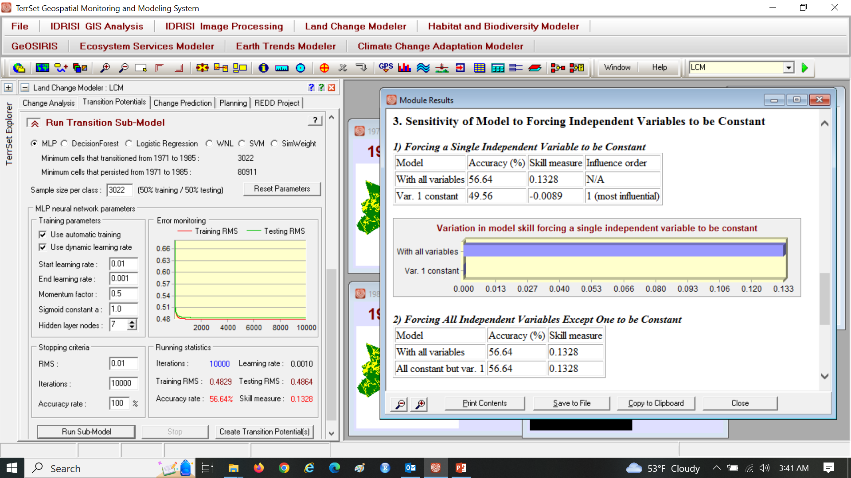
Assignment 4

Slide 13
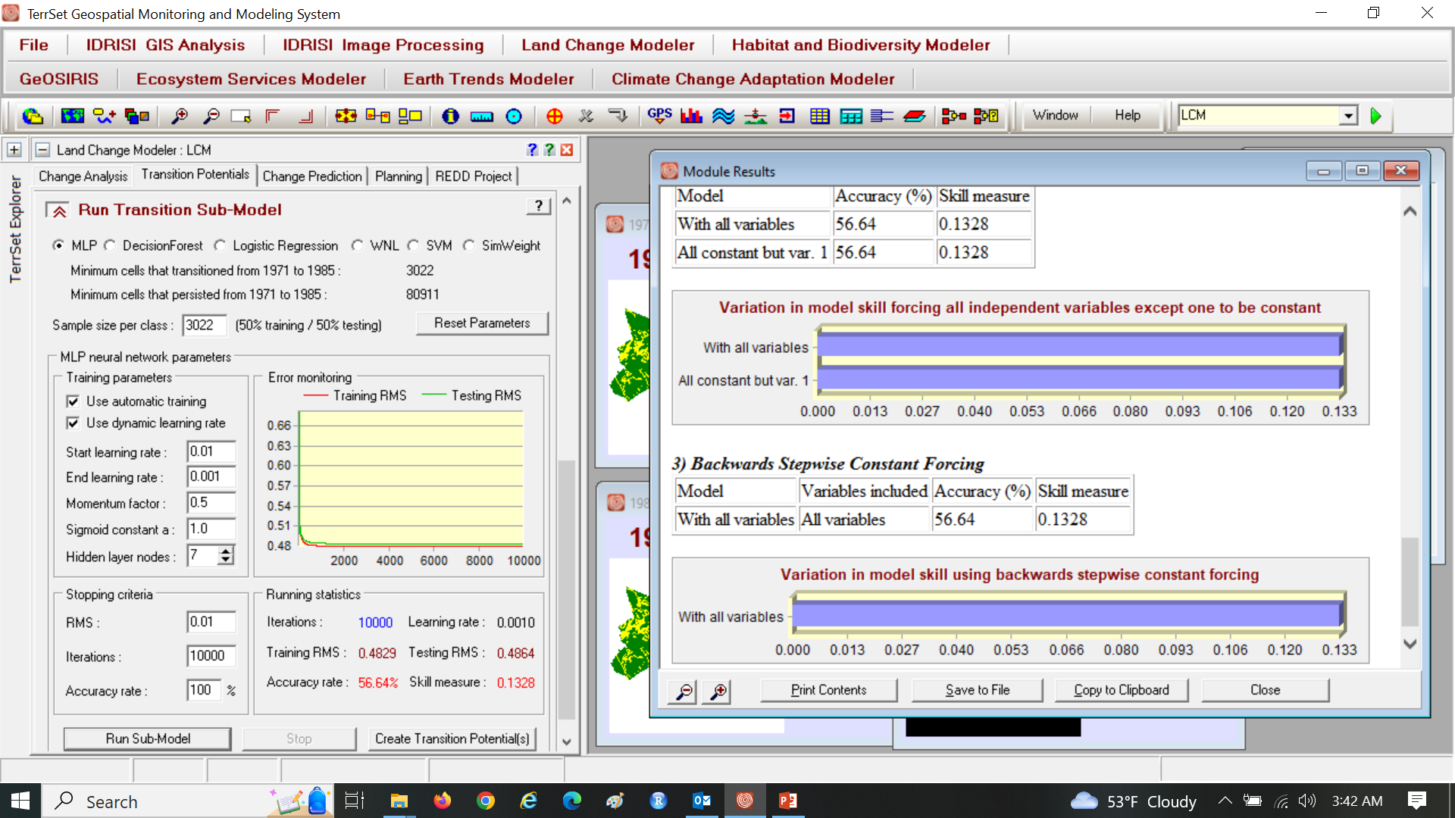
Assignment 4

Slide 14
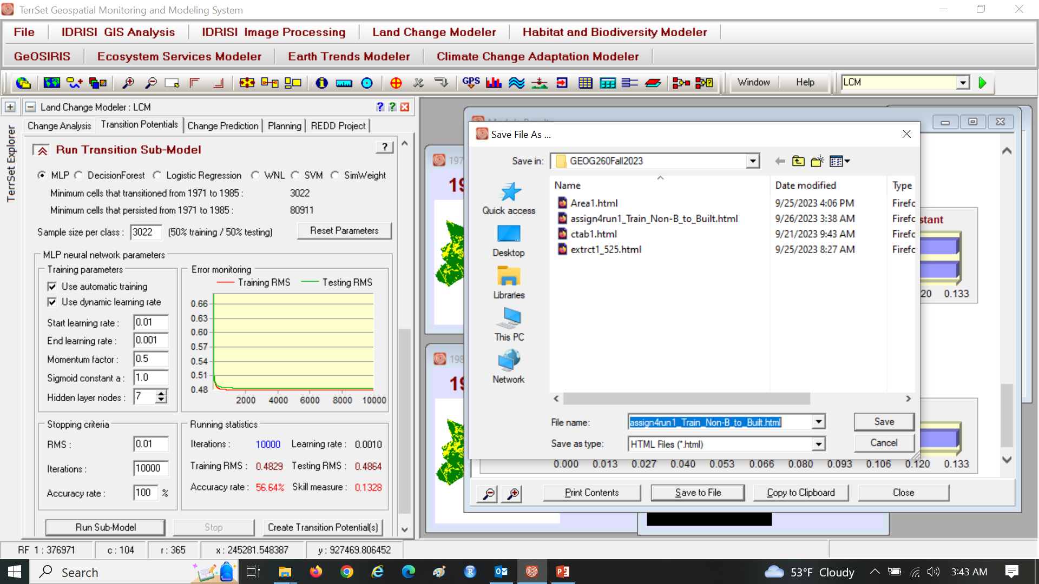
Save the output as a html file

Slide 15
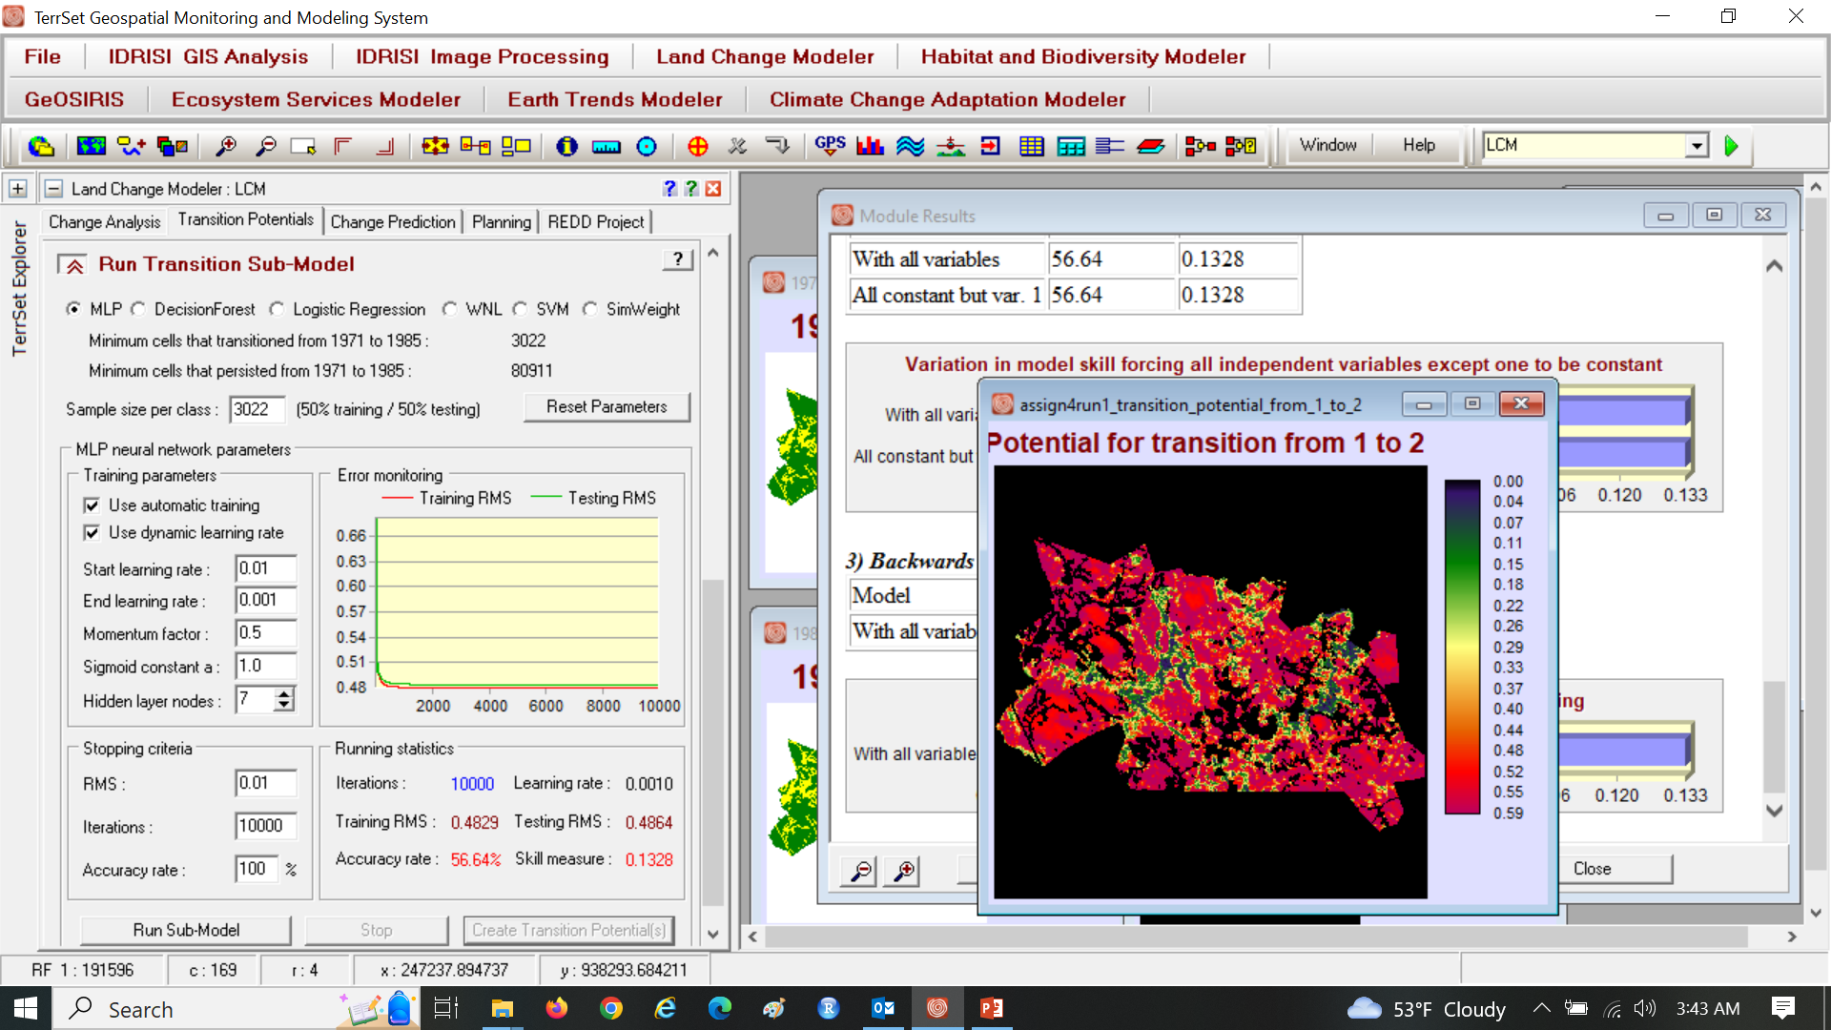
Create Transition Potential(s)

Slide 16
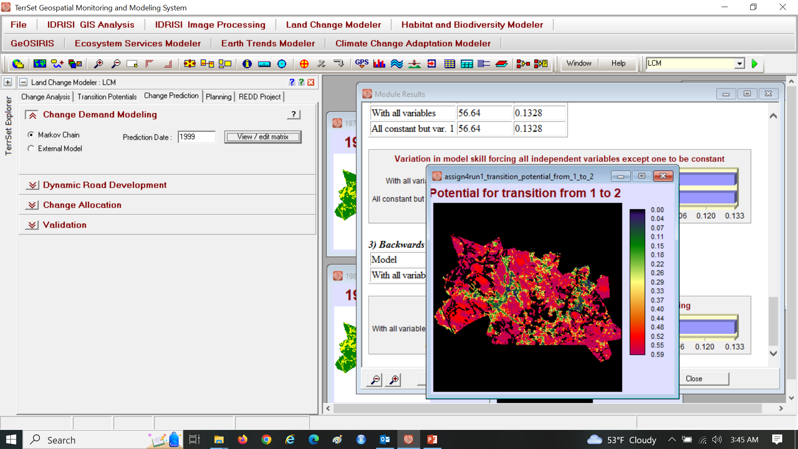
Set Prediction Date as 1999. Click View/edit matrix.

Slide 17
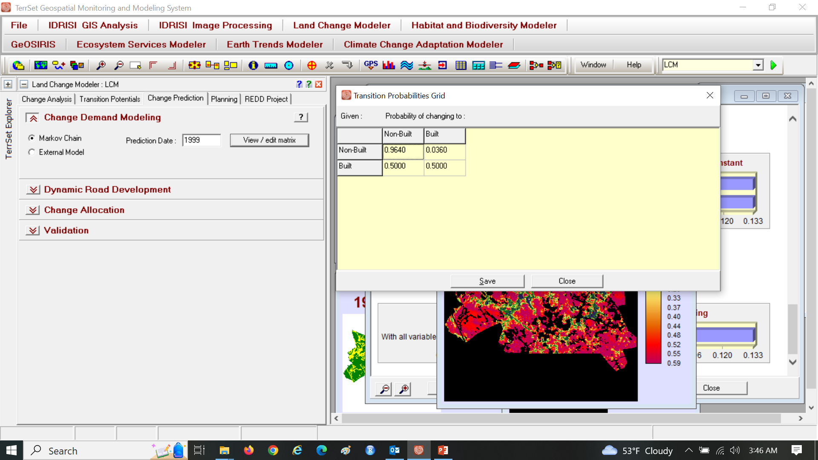
Built Row means half of start Built will become Non-Built.

Slide 18

Assignment 4 Change Built Row then Save

Slide 19
Interpret Markov Matrix
Size of Transition from Non-Built to Built as a proportion of Non-Built at start of each 14-year time interval.
Size of Transition from Built to Built as a proportion of Built at start of each 14-year time interval.
In a Markov Matrix:
Rows show the start categories that transition from the start time.
Columns show the categories that transition to the end time.
M_{ij} = (Size of transition from category in row i to column j)/(Size of category in row i)
The entries in each row sum to 1.
Markov shows an exponential decay of Non-Built, not an exponential growth of Built.

Slide 20
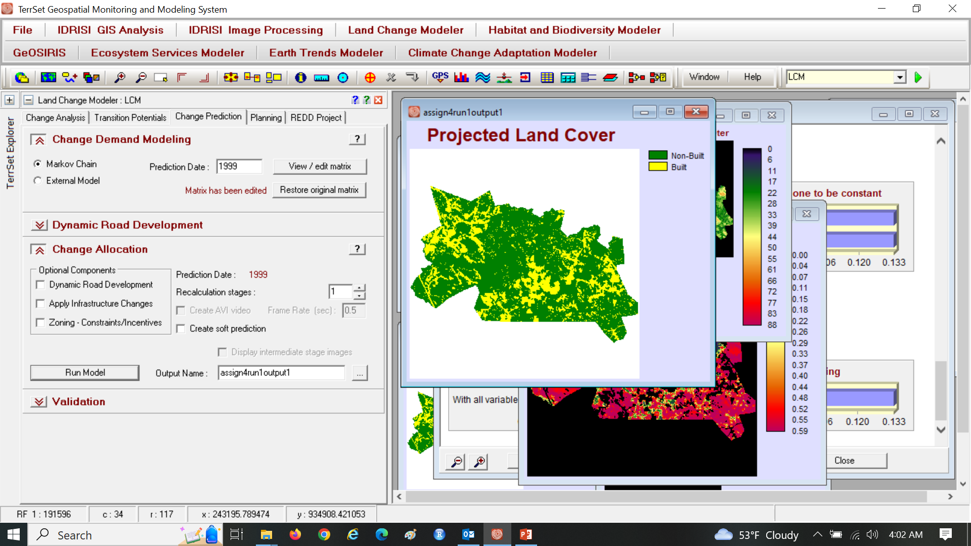
Assignment 4

Slide 21
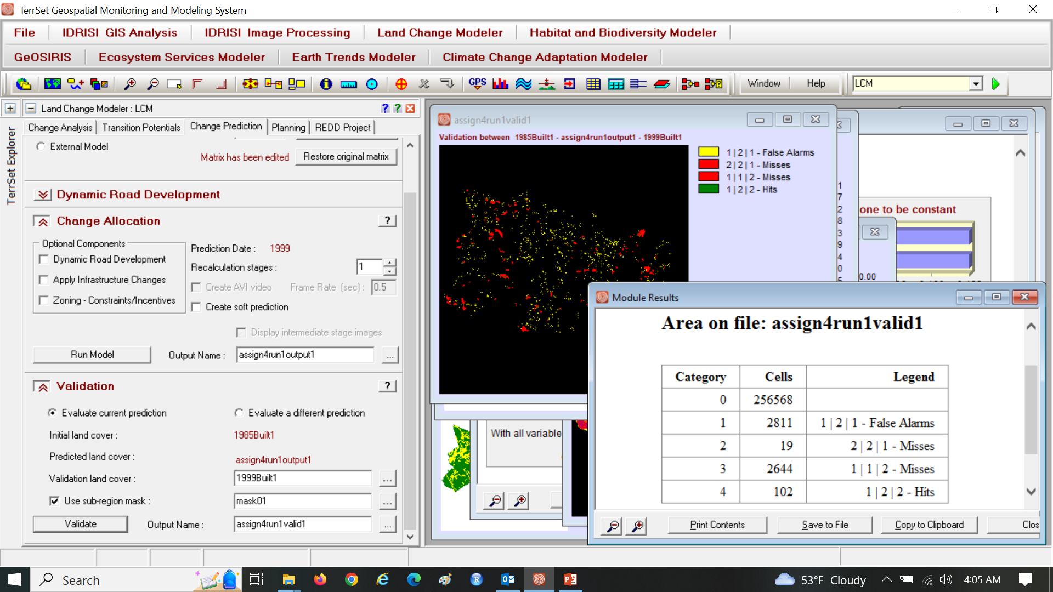
What is the difference between two types of misses?

Slide 22
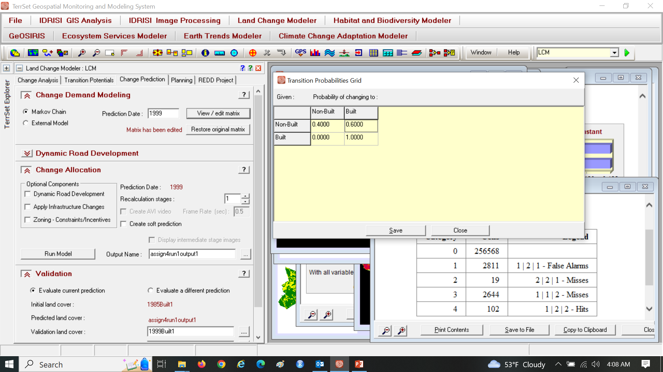
Edit matrix so 0.6 of start Non-Built becomes Built

Slide 23
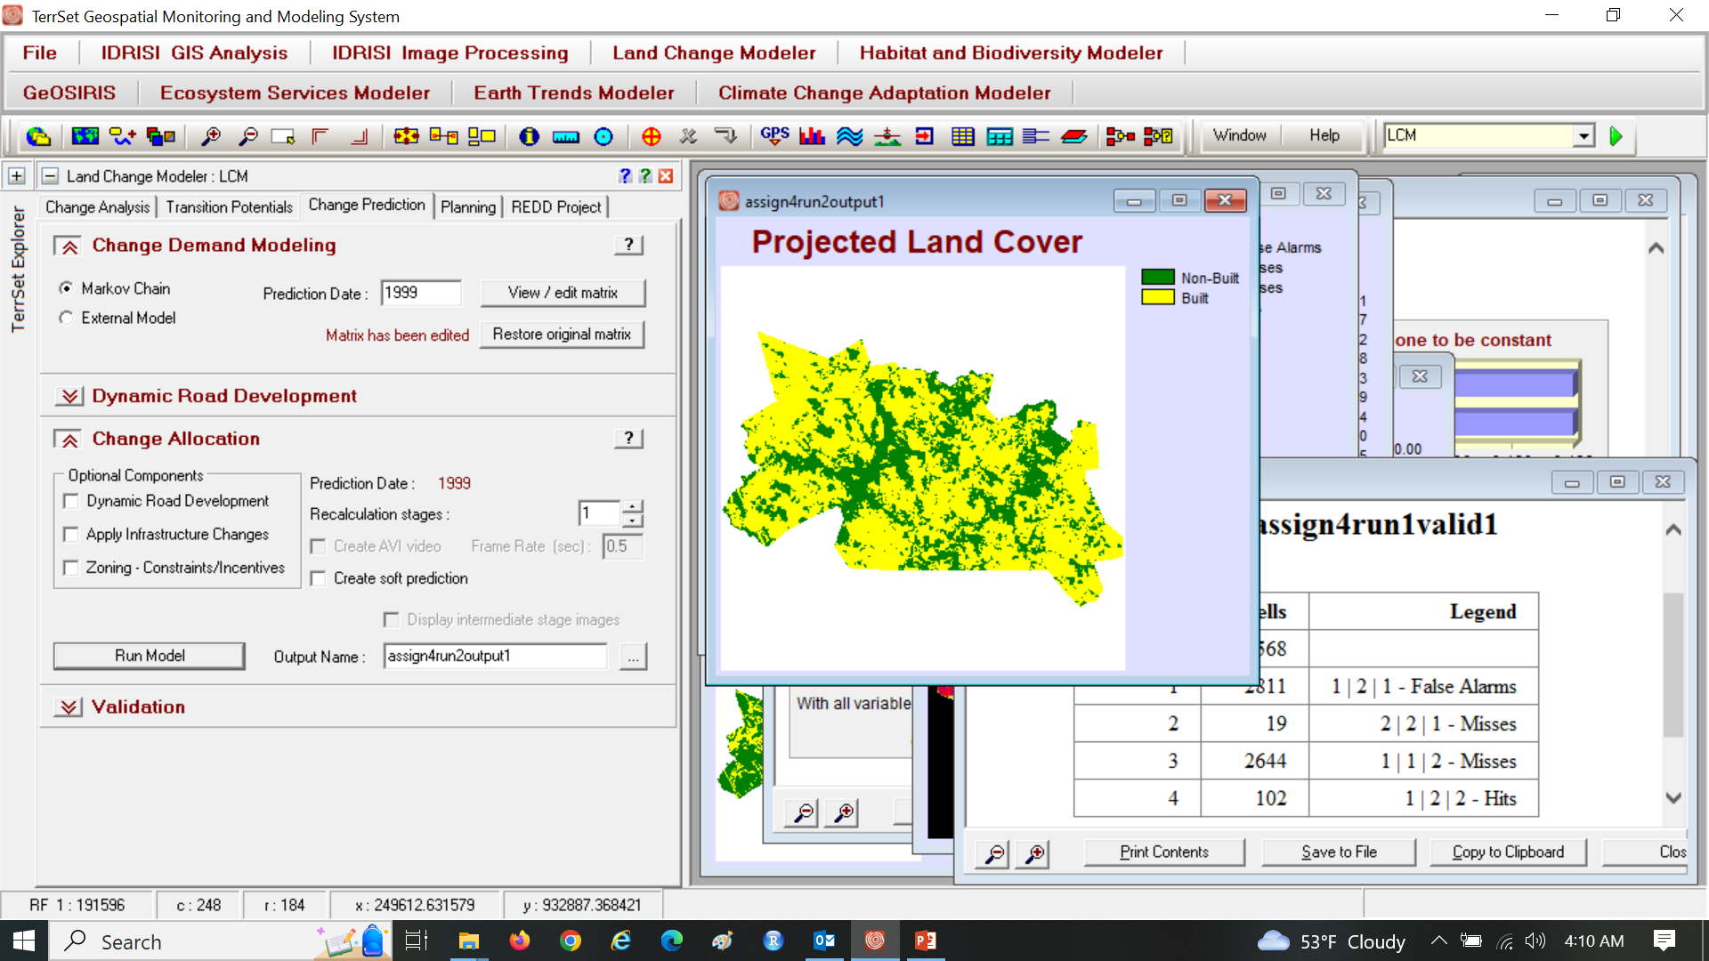
Assignment 4

Slide 24
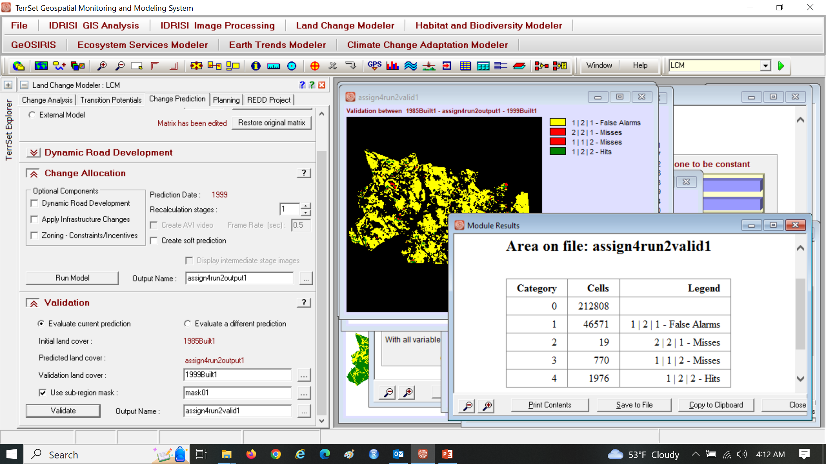
Assignment 4

Slide 25
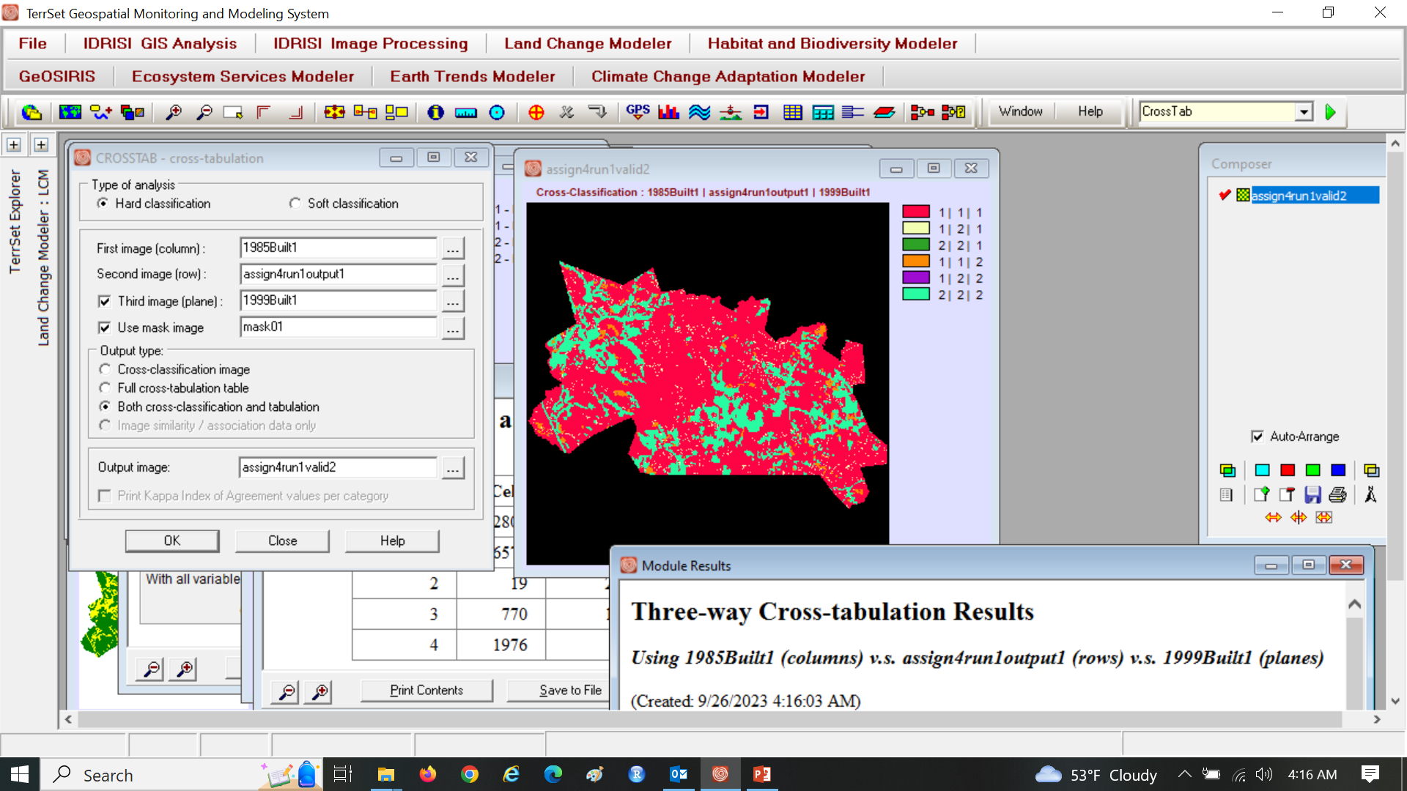
Assignment 4

Slide 26
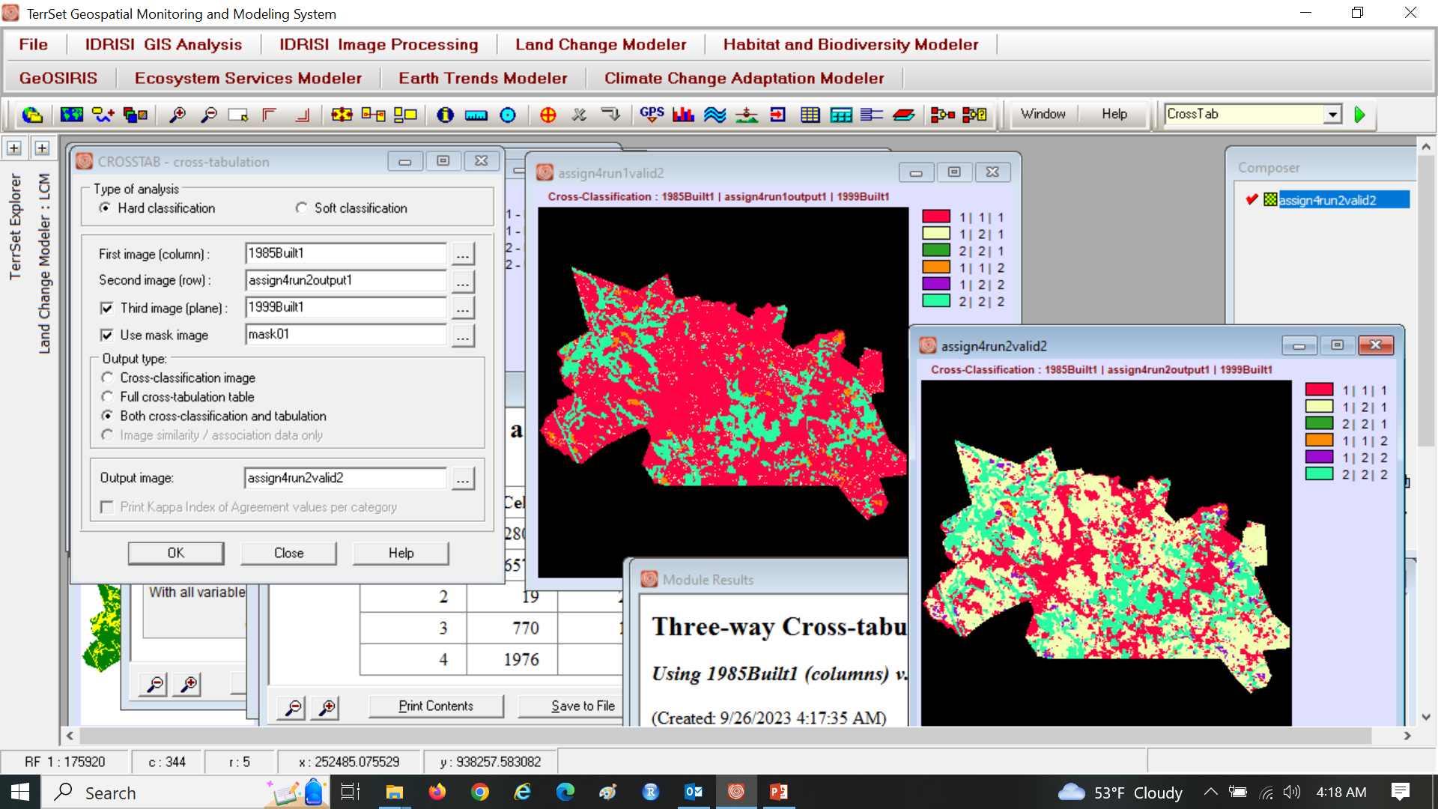
Assignment 4

Slide 27
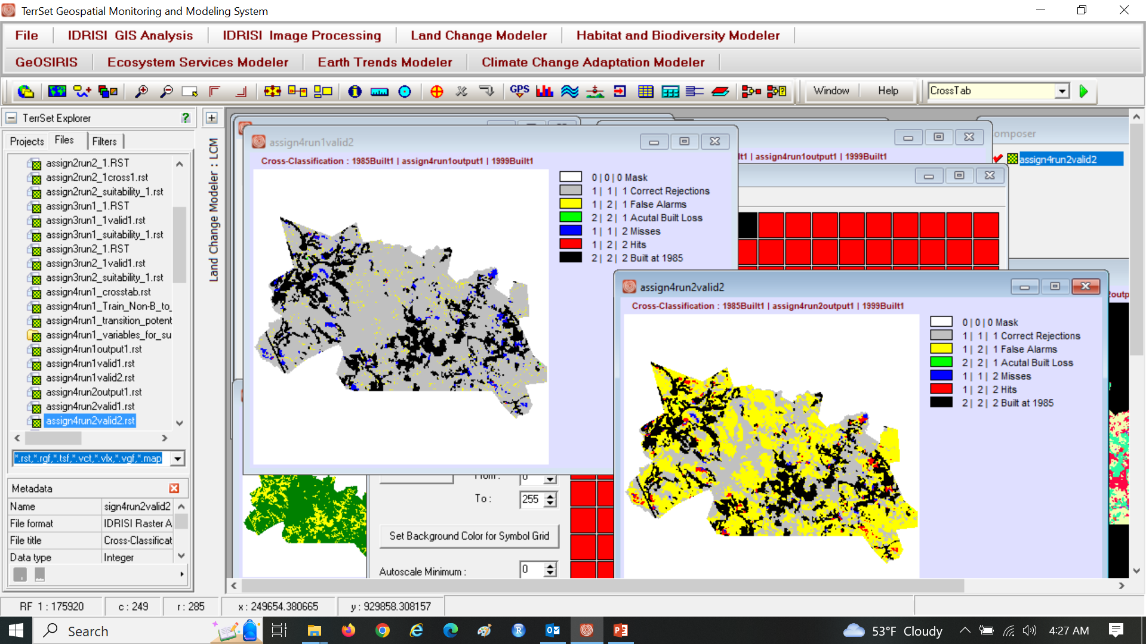
Assignment 4

